Slide 1

Vel Tech Rangarajan Dr. Sagunthala R&D Institute of Science and Technology
School of Computing
Department of Computer Science and Engineering
10211CS224 / FULL STACK APPLICATION DEVELOPMENT (JAVA)
PROJECT REVIEW : MILESTONE PROJECT – 2
Date: 06-05-2026
HireSphere – Where Talent meets Oppurtunity
SDG: SDG 8 – Decent Work and Economic Growth
Presented By:
Kunchapu Vandana– VTU24401–23UECS0788
Courses Handling Faculty:
Dr.S.Hemamalini (TTS4062)

Slide 2
INTRODUCTION
1
2
HireSphere – Where Talent Meets Opportunity is a web-based job portal designed to connect job seekers and employers through a single, user-friendly platform. In today’s digital era, traditional recruitment methods are often time-consuming and inefficient. This system provides an organized solution where candidates can search for jobs, create profiles, and apply easily based on their skills and preferences.
The platform also enables employers to post job vacancies, review applications, and select suitable candidates efficiently. With features like search filters, email notifications, and real-time communication, HireSphere improves the overall hiring experience. It aims to bridge the gap between talent and opportunity by making the recruitment process faster, simpler, and more effective.
3
4
5
6
7
8
9

Slide 3
PROBLEM STATEMENT
1
2
In today’s competitive job market, the process of connecting job seekers with suitable employment opportunities and helping employers find the right candidates is often inefficient and time-consuming. Traditional recruitment methods lack proper organization, transparency, and speed, making it difficult for candidates to discover relevant jobs and for employers to identify qualified applicants quickly.
There is a need for a centralized, user-friendly platform that simplifies job searching, application management, and candidate selection. The system should reduce the communication gap, improve accessibility, and provide efficient tools for both job seekers and employers to interact seamlessly and make better hiring decisions.
3
4
5
6
7
8
9

Slide 4
OBJECTIVE(S)
To develop an online platform that connects job seekers with employers efficiently.
To simplify the job search and recruitment process through digital technology.
To provide users with updated job opportunities based on their skills and qualifications.
To enable employers to post job vacancies and manage applications easily.
To reduce unemployment by increasing access to job opportunities.
To provide a user-friendly interface for registration, login, and job applications.
To improve communication between recruiters and candidates.
1
2
3
4
5
6
7
8
9

Slide 5
PROPOSED SYSTEM
1
The proposed system is a web-based Job Portal designed to connect job seekers and employers through a single digital platform. The system allows users to register, create profiles, upload resumes, search for jobs, and apply online. Employers can create company accounts, post job vacancies, view applications, and shortlist suitable candidates.
The portal provides an easy and efficient recruitment process by reducing manual work and saving time for both recruiters and applicants. It includes features such as job search filters, secure login, application tracking, and notification updates.
The proposed system aims to improve employment accessibility, simplify hiring procedures, and create a user-friendly environment for job placement and career opportunities.
2
3
4
5
6
7
8
9

Slide 6
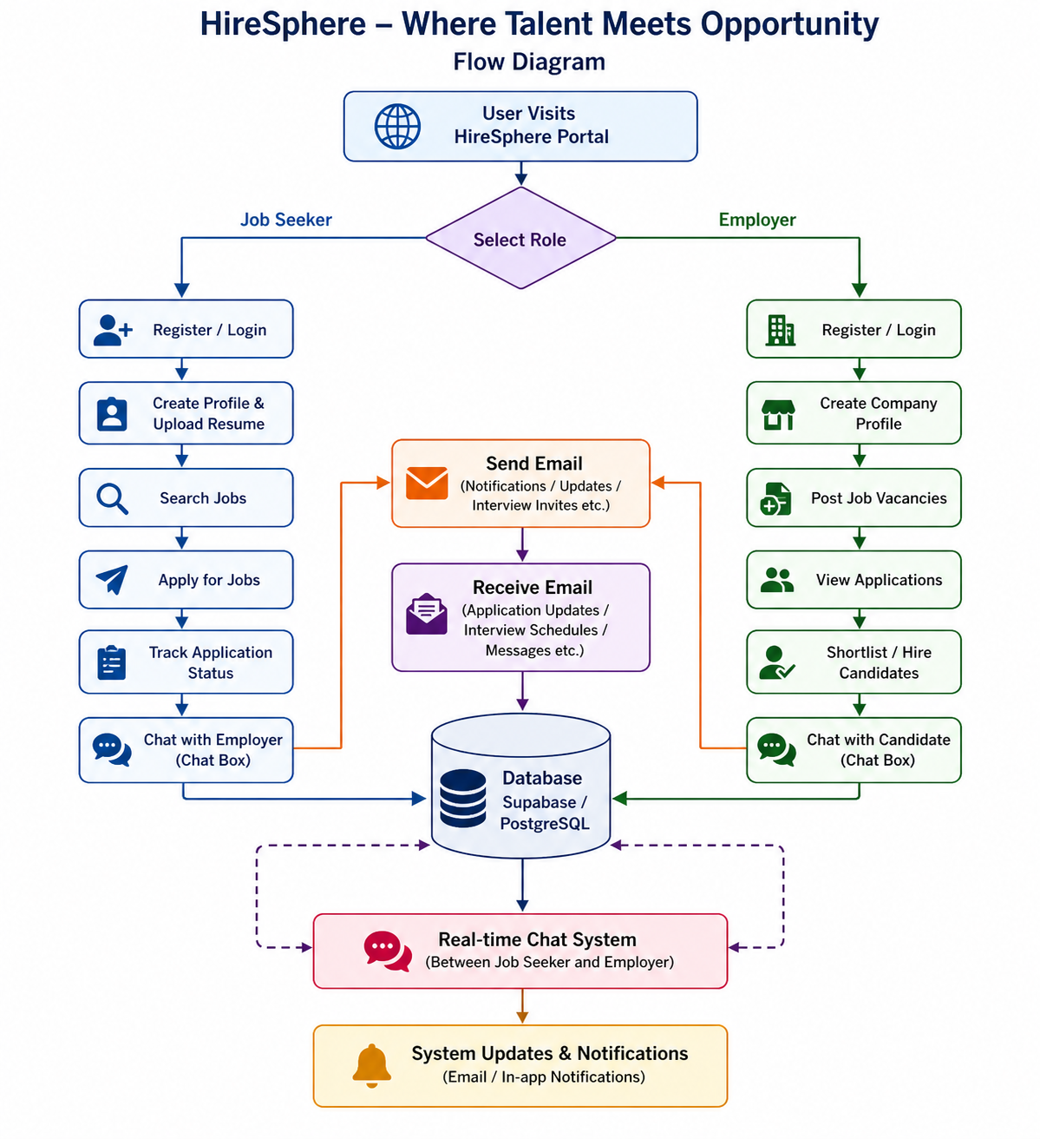
PROPOSED SYSTEM ARCHITECTURE
1
User Authentication Module: Handles login, registration, and session management using Supabase Auth, supporting email/password and potentially OAuth integrations for enhanced security.
Job Management Module: Allows employers to create and post job listings with details like title, description, requirements, and location. Job seekers can browse, filter, and view detailed job pages.
Dashboard Module: Provides personalized views for users—job seekers see applied jobs and recommendations, while employers track applications and manage postings.
Application Process: Users can apply directly through the portal, with data flowing securely to the database for employer review.
Additional Features: Includes a contact page for inquiries, responsive design for mobile/desktop access, and potential future integrations like notifications or advanced search.
2
3
4
5
6
7
8
9

Slide 7
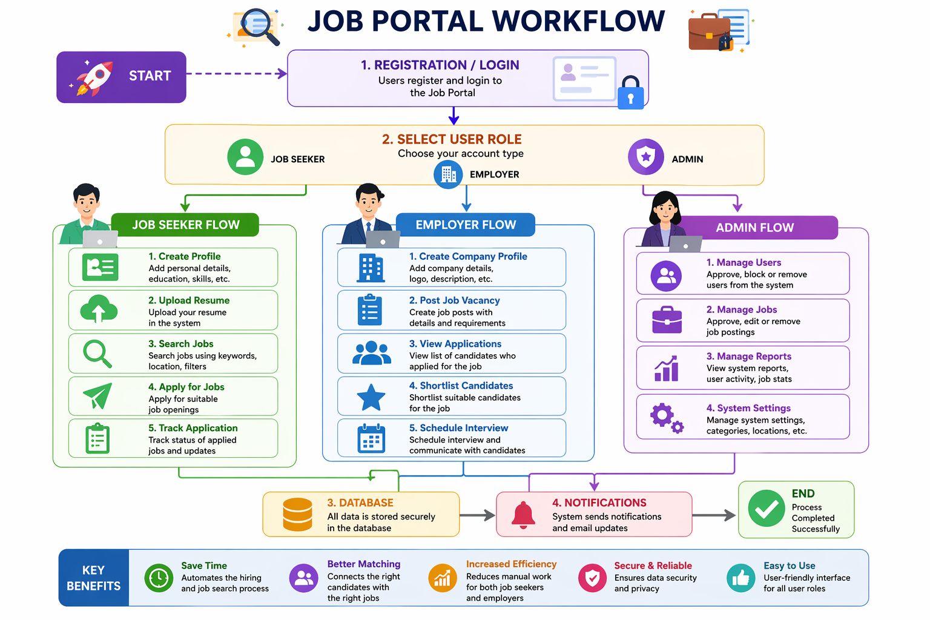
WORKFLOW
1
2
3
4
5
6
7
8
9

Slide 8
TECHNOLOGIES USED
Frontend:
React.js
TypeScript
Css , HTML , JavaScript
Backend:
Node.js
Authentication and Session Management
Database:
MySQL / PostgreSQL (Relational Database)
Tools:
Visual Studio Code
Git / GitHub (version control)
Hardware/Software Requirements:
Hardware: PC/Laptop with at least 4GB RAM, 500GB storage
Software: Web browser, MySQL/PostgreSQL server, Python/PHP runtime environment, Internet connection for updates and job alerts.
1
2
3
4
5
6
7
8
9

Slide 9
MODULE DESCRIPTION
Module 1: User Management
Handles user registration, login, and profile management for all users. It supports role-based access control for Job Seekers, Employers, and Admin, ensuring secure authentication and proper access to system features.
Module 2: Job Management
Allows employers to create, update, and delete job postings. It manages job details such as job title, description, required skills, location, and number of vacancies.
Module 3: Candidate Management
Enables job seekers to create profiles, upload resumes, search for jobs, and apply for suitable positions. It also tracks the application history of each candidate.
Module 4: Recruitment Management
Helps employers manage the hiring process by viewing applications, shortlisting candidates, scheduling interviews, and updating recruitment status.
Module 5: Communication Management
Includes email notifications and real-time chat functionality. It allows interaction between job seekers and employers, sending updates like interview calls, application status, and messages.
Module 6: Database Management
Stores and manages all system data including user profiles, job postings, resumes, applications, and messages in a secure and structured database.
1
2
3
4
5
6
7
8
9

Slide 10
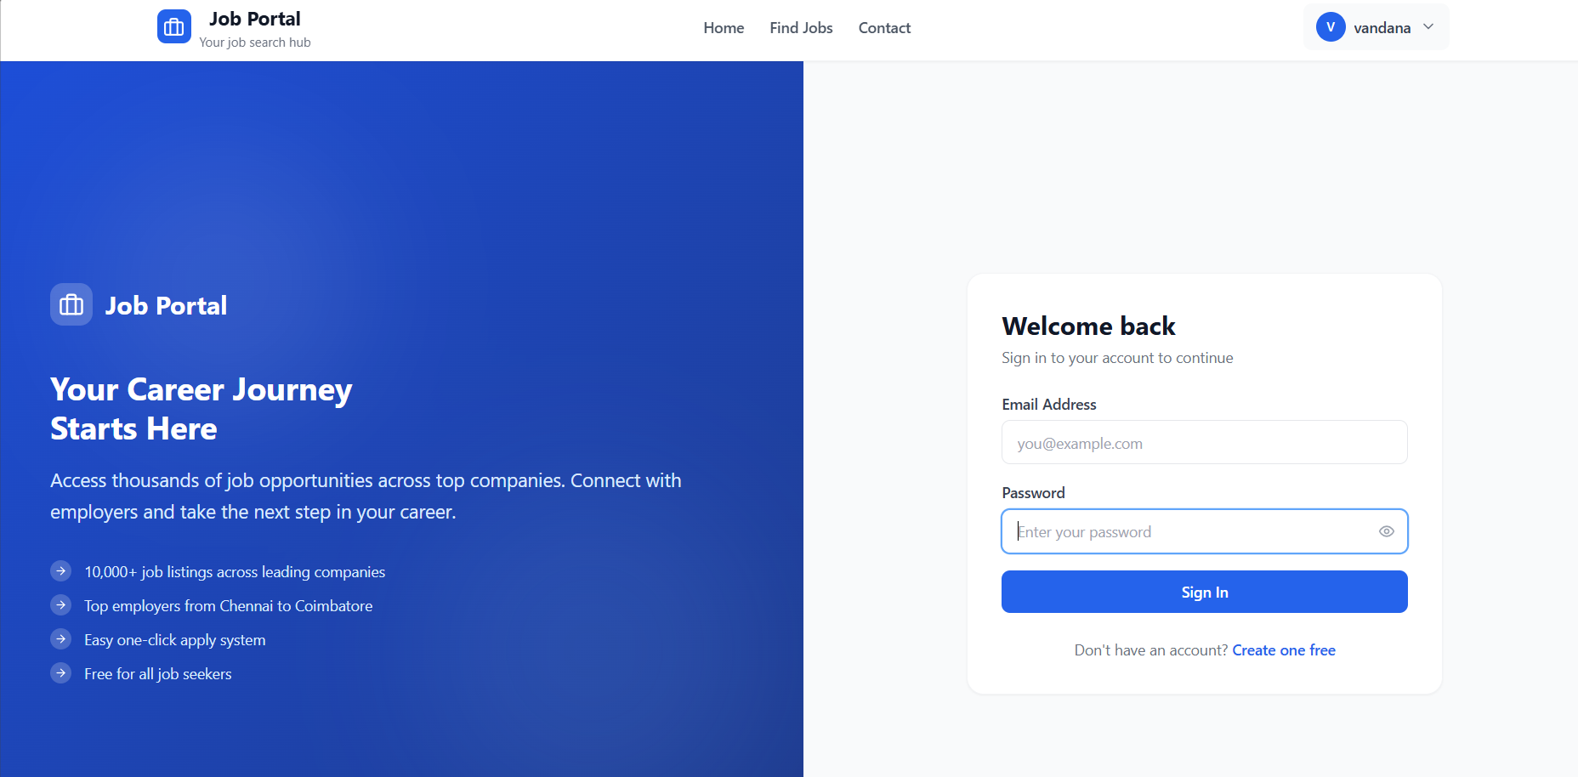
IMPLEMENTATION SCREENSHOTS
1
2
3
4
5
6
7
8
9

Slide 11
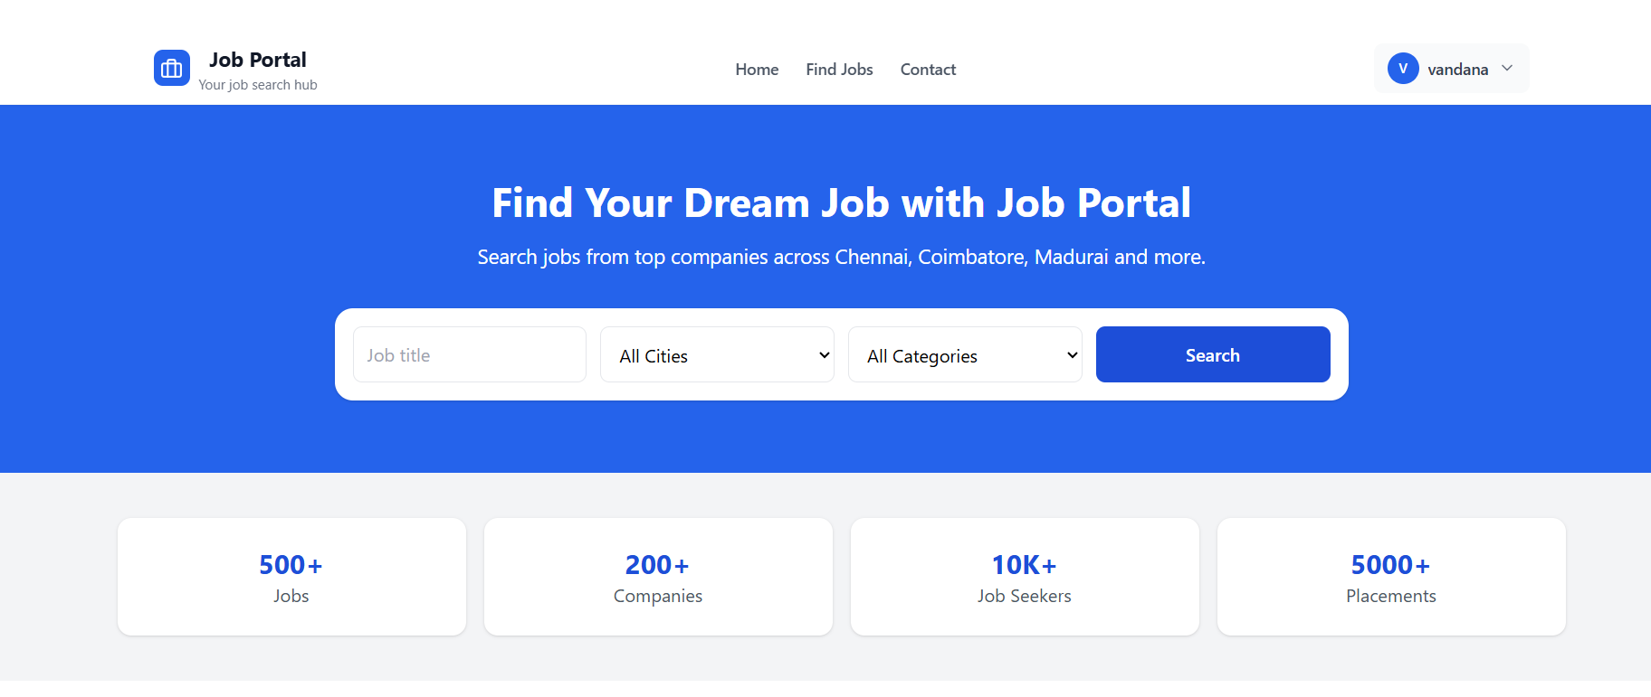
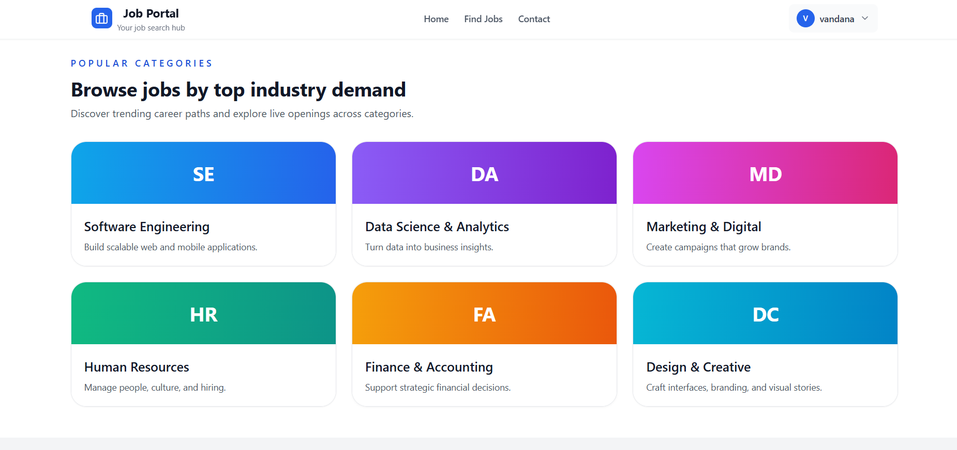
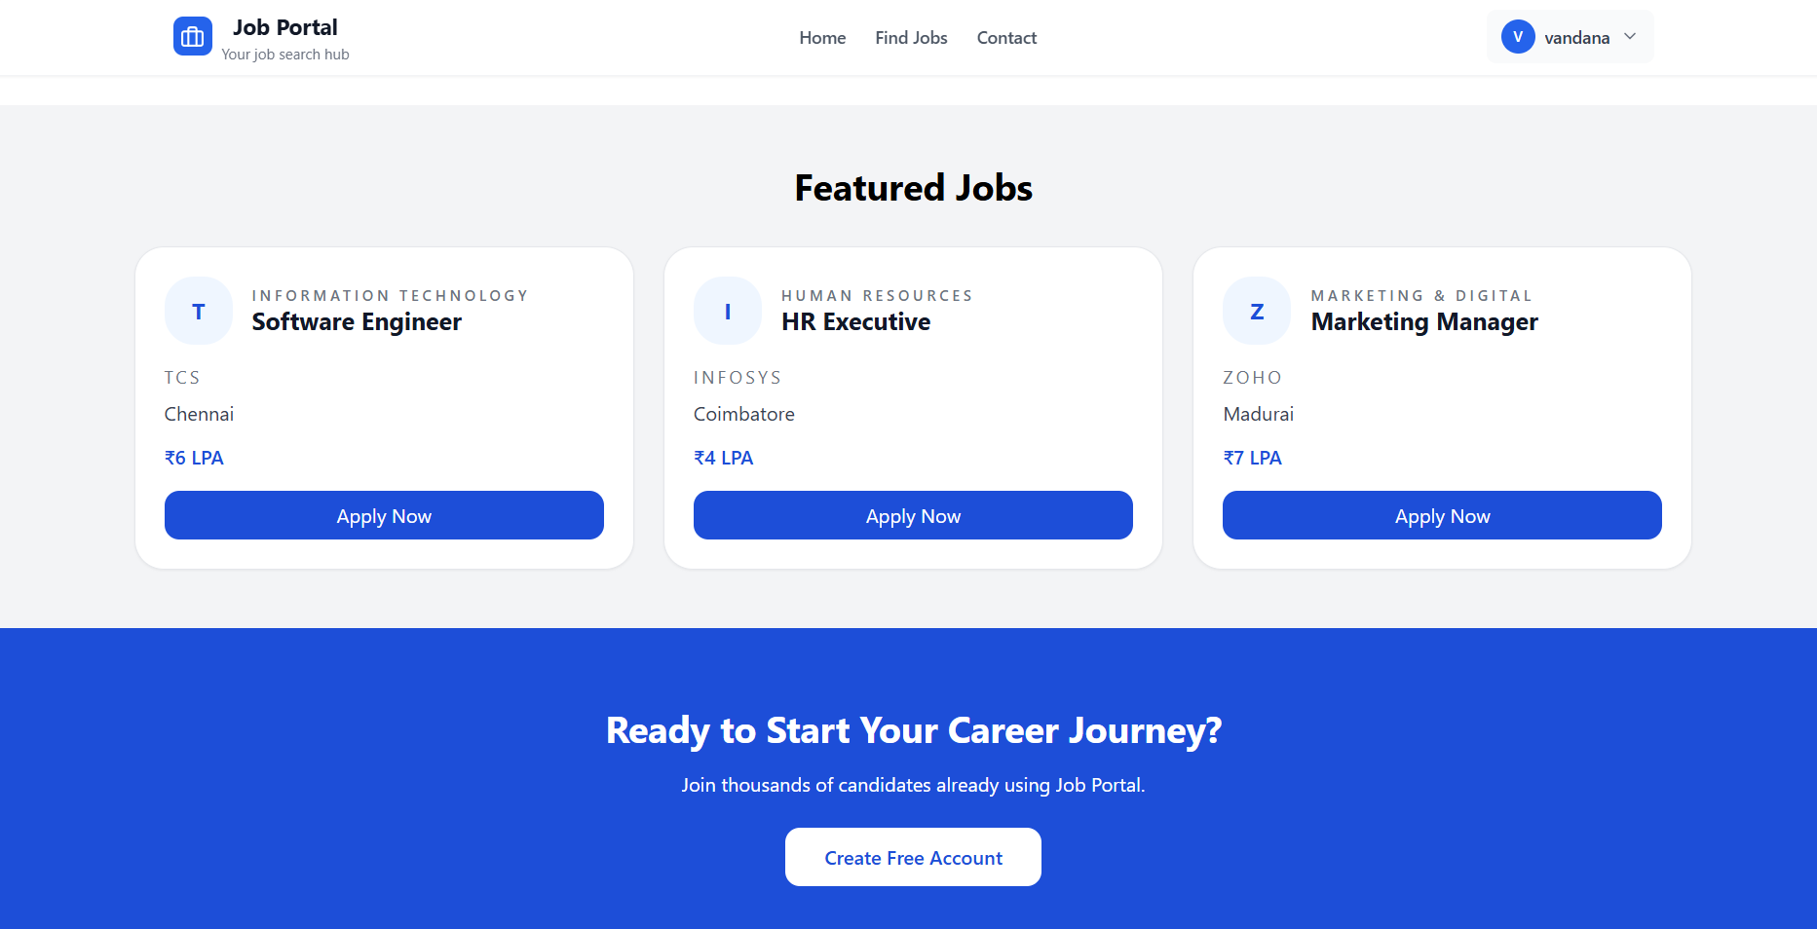
IMPLEMENTATION SCREENSHOTS
1
2
3
4
5
6
7
8(A)
9

Slide 12
ADVANTAGES & LIMITATIONS
Advantages
Provides easy access to job opportunities anytime and anywhere.
Reduces time and cost in the recruitment process.
Allows quick job search using filters such as location, salary, and skills.
Improves communication through notifications and alerts.
Limitations
Requires internet connection for access and updates.
Fake job postings or fraudulent users may occur if not monitored properly.
Limited opportunities if employers do not actively post jobs.
Data privacy and security risks if protection is weak.
1
2
3
4
5
6
7
8
9

Slide 13
Thank you

